Slide 1
SMART IRRIGATION SYSTEM

Slide 2
Project objectives
To save water and reduce human intervention in the agriculture field
Continuously monitoring the status of sensors and provide signal for taking necessary action
To get the output of soil water sensor and provide water to crop
To observe other parameters for better yields

Slide 3
Introduction
Monsoon dependent indian agriculture
Automatic irrigation
Over irrigation and under irrigation
Soil moisture,temperature, air humidity and water level in the soil are wirelessly transmitted using wireless technology for better production

Slide 4
Components used
Sensors
ESP 32
Motor
Motor driver
Jumper wires

Slide 5
Sensors
For this project we require three sensors namely
Moisture sensor
Ultrasonic sensor
IR sensor

Slide 6
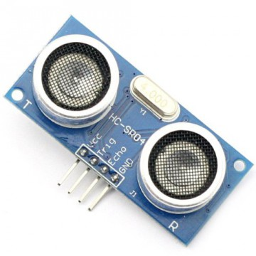
Ultrasonic sensor
SPECIFICATIONS:
Operated at 5V
Measuring distance:2cm-450cm
Here the module has two projects in the front which form as ultrasonic transmitter and receiver
PURPOSE:
Transmitter transmits an ultrasonic wave which is received back by the receiver which is reflected back when the wave is objected by the water and the distance is calculated

Slide 7
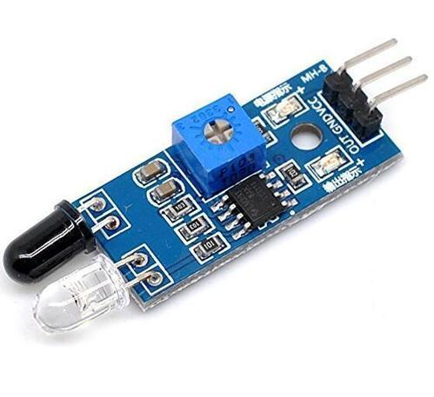
IR sensor
SPECIFICATIONS:
Operated at 5V
Module consists mainly of IR transmitter and receiver,variable resistor and output LED
PURPOSE:
Used to detect the obstacle (i.e., presence or absence of an object)

Slide 8
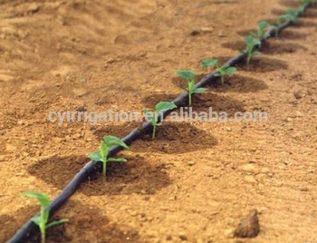
Drip irrigation
It is a technique in which water flows through a filter into special drip pipes with emitters located at different spacing.
It is most efficient water and nutrient delivery system.

Slide 9
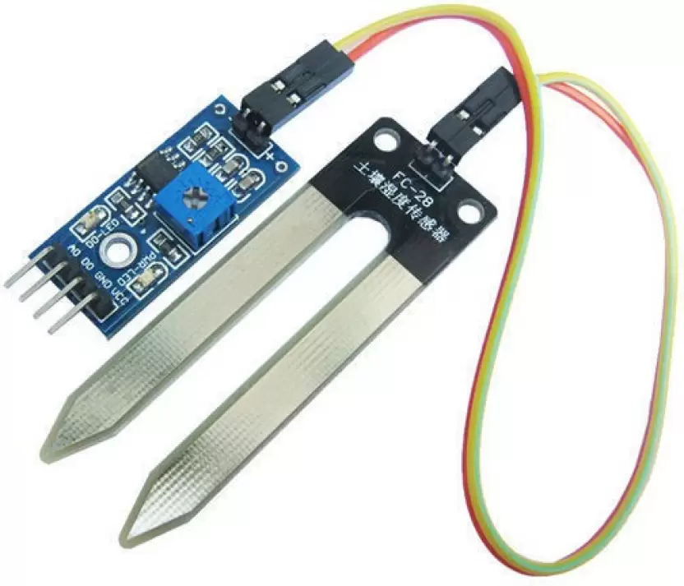
Moisture sensor
SPECIFICATIONS:
Common type is frequency domain
Neutron moisture gauge
Input voltage:12VDC
PURPOSE:
In this sensor we are using two probes to be dipped into the soil as per moisture we will get analog output variations from 0.6-12v

Slide 10
Block diagram
POWER
SUPPLY
ESP32
IR SENSOR
THINGSPEAK
ULTRASONIC
SENSOR
DC MOTOR
MOISTURE SENSOR
WEB PAGE

Slide 11
Flow chart
START
IR ULTRASONIC MOISTURE SENSOR VALUES
IF SENSOR VALUES==
THRESHOLD VALUES
YES
NO
MOTOR ON
MOTOR OFF

Slide 12
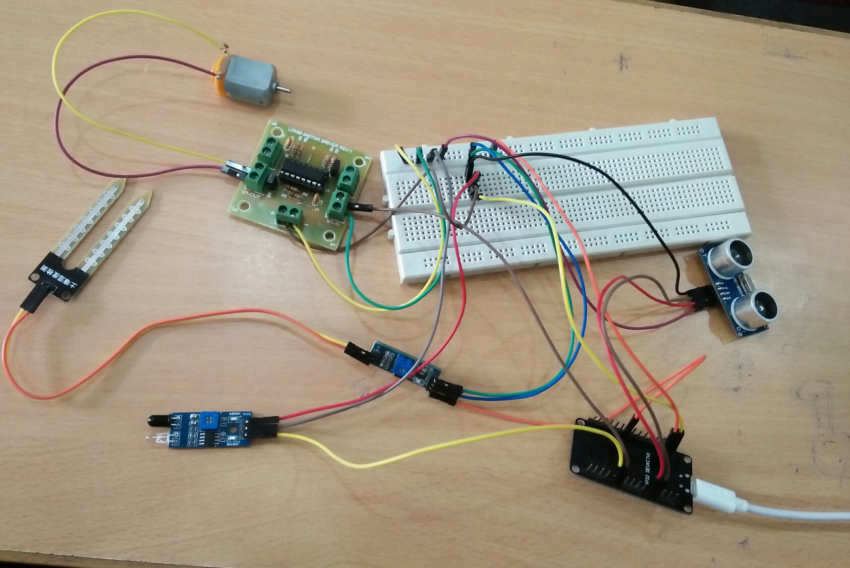
Hardware connection

Slide 13
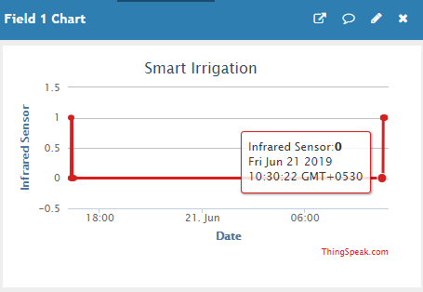
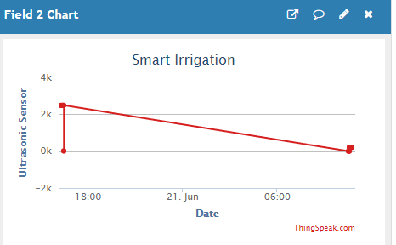
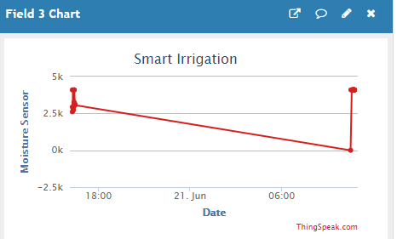
Graphical representation

Slide 14
Advantages
Increase in productivity
Reduced water consumption
No manpower required
Reduce soil erosion and nutrient leaching
Requires smaller water sources

Slide 15
Disadvantages
Complexity
Lesser employment of manual staff or unskilled workers
Equipment is costlier
Awareness of farmers of this technology

Slide 16
Conclusion
Smart irrigation system is feasible and cost effective for optimizing water resources for agricultural production
This irrigation system allows cultivation in places with water scarcity thereby improving sustainability
It proves that the use water can be diminished

Slide 17
Project by
Y Spandhana
A Shreya
T Sree Varsha

Slide 18
THANK YOU

